Slide 1
Module 3
Cloud Infrastructure Mechanisms

Slide 2
Contents
Network perimeter
Virtual server
Cloud storage device
Cloud usage monitor.
Resource replication.

Slide 3
Cloud Infrastructure Mechanisms
Cloud infrastructure mechanisms are the fundamental building block of cloud computing environment. It need the following components.
Logical Network perimeter– Techniques to implement networks in cloud.
Virtual server -- Techniques to implement machines in cloud.
Cloud storage device -- Techniques to implement storage in cloud.
Cloud storage monitor -- Techniques to implement monitor usage of cloud resource.
Resource replication-- Techniques to implement replicate resources in cloud.
Ready-made environment -- Techniques to provide read made platform solution to do.

Slide 4
3.1 Logical Network Perimeter
The logical network perimeter establishes the virtual network boundary that can include and isolate group of related Cloud based IT resources that may be physically distributed.
This can be implemented to
Isolate IT resources in a cloud from non-authorized users.
Isolate IT resources in a cloud from non-users
Isolate IT resources in a cloud from cloud consumers .
Control the bandwidth that is available to isolated IT resources.

Slide 5
Contin..
Logical network perimeters are established via network devices that supply and control the connectivity of data center and its IT resources are virtualized that include
Virtual Firewall – It is a protection software that provides the network traffic filtering and monitoring for virtual machines in a virtualized environment.
Virtual Network – This is IT resource that isolates the network environment within the data center infrastructure.
Ex: VPAN,VLAN
VPAN restricts the browsing history to public.
Facilitates encryption.

Slide 6
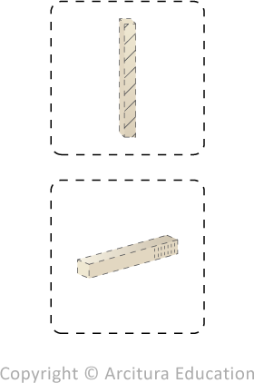
Virtual firewall (top) and virtual network. (bottom)

Slide 7
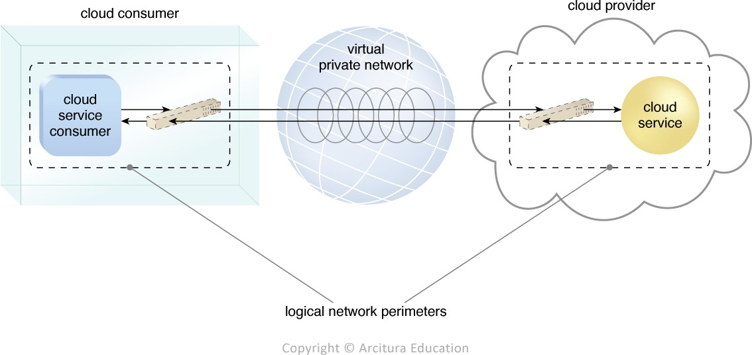
Two logical network perimeters surround the cloud consumer and cloud provider environments.
In which one logical network perimeter contains a cloud consumer’s on-premise environment, while another contains a cloud provider’s cloud-based environment.
These perimeters are connected through a VPN that protects communications, since the VPN is typically implemented by point-to-point encryption of the data packets sent between the communicating endpoints.

Slide 8
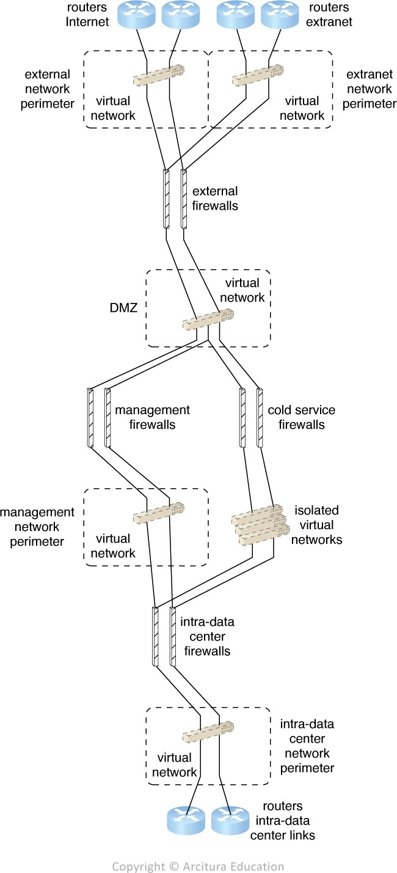
DTGov Logical network perimeter
The virtual firewalls are allocated to and controlled by a single cloud consumer in order to regulate its virtual IT resource traffic. These IT resources are connected through a virtual network that is isolated from other cloud consumers. The virtual firewall and the isolated virtual network jointly form the cloud consumer’s logical network perimeter.
Figure - Logical network layout is established through a set of logical network perimeters using various firewalls and virtual networks.

Slide 9
3.2 Virtual Server
A virtual server is a form of virtualization software that emulates the physical server.
Which are used by cloud providers to share the same physical server with multiple cloud consumers with individual virtual server instances.

Slide 10
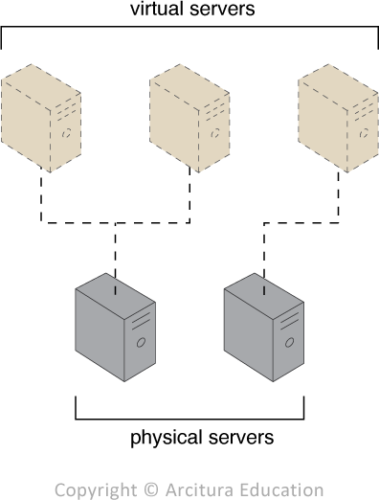
The first physical server hosts two virtual servers, while the second physical server hosts one virtual server.

Slide 11
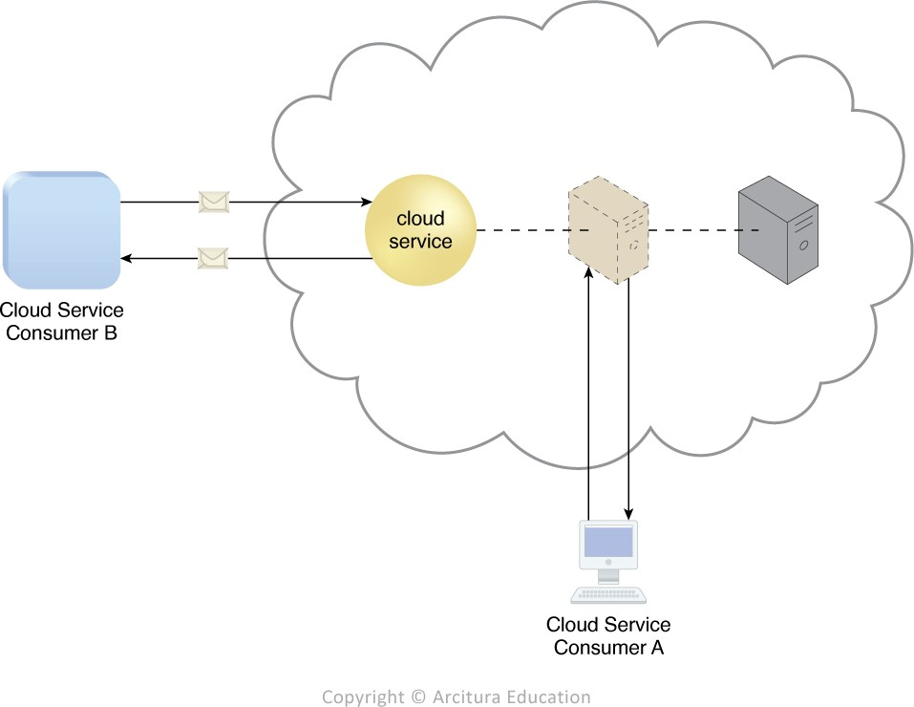
Virtual server that hosts a cloud service being accessed by Cloud Service Consumer B, while Cloud Service Consumer A accesses the virtual server directly to perform an administration task.
A virtual server hosts an active cloud service and is further accessed by a cloud consumer for administrative purposes.

Slide 12
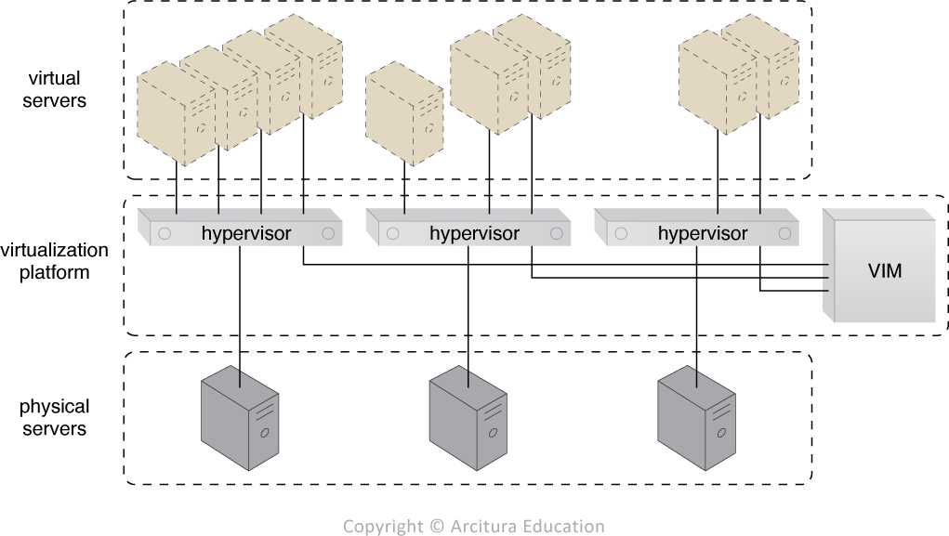
DTGov Virtual server
Several virtual servers running over physical servers, all of which are jointly controlled by a central VIM.

Slide 13
In order to enable the on-demand creation of virtual servers, DTGOV provides cloud consumers with a set of template virtual servers that are made available through pre-made VM images.
These VM images are files that represent the virtual disk images used by the hypervisor to boot the virtual server. DTGOV enables the template virtual servers to have various initial configuration options that differ, based on operating system, drivers, and management tools being used. Some template virtual servers also have additional, pre-installed application server software.
The following virtual server packages are offered to DTGOV’s cloud consumers. Each package has different pre-defined performance configurations and limitations:

Slide 14
Small Virtual Server Instance – 1 virtual processor core, 4 GB of virtual RAM, 20 GB of storage space in the root file system.
Medium Virtual Server Instance – 2 virtual processor cores, 8 GB of virtual RAM, 20 GB of storage space in the root file system.
Large Virtual Server Instance – 8 virtual processor cores, 16 GB of virtual RAM, 20 GB of storage space in the root file system
Memory Large Virtual Server Instance – 8 virtual processor cores, 64 GB of virtual RAM, 20 GB of storage space in the root file system
Processor Large Virtual Server Instance – 32 virtual processor cores, 16 GB of virtual RAM, 20 GB of storage space in the root file system
Ultra-Large Virtual Server Instance – 128 virtual processor cores, 512 GB of virtual RAM, 40 GB of storage space in the root file system

Slide 15
Additional storage capacity can be added to a virtual server by attaching a virtual disk from a cloud storage device.
All of the template virtual machine images are stored on a common cloud storage device that is accessible only through the cloud consumers’ management tools that are used to control the deployed IT resources.
Once a new virtual server needs to be instantiated, the cloud consumer can choose the most suitable virtual server template from the list of available configurations. A copy of the virtual machine image is made and allocated to the cloud consumer, who can then assume the administrative responsibilities.
The allocated VM image is updated whenever the cloud consumer customizes the virtual server.
After the cloud consumer initiates the virtual server, the allocated VM image and its associated performance profile is passed to the VIM, which creates the virtual server instance from the appropriate physical server.

Slide 16
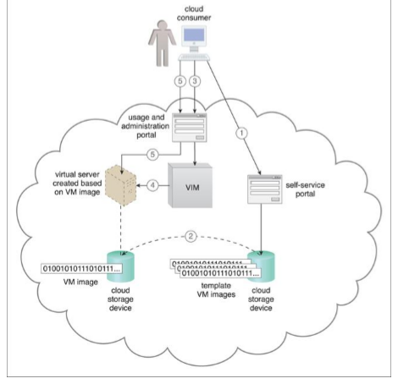
DTGov uses the process which is shown in figure for the creation and management of virtual servers that have different initial software configurations and performance characteristics.
The cloud consumer uses the self-service portal to select a template virtual server for creation (1). A copy of the corresponding VM image is created in a cloud consumer-controlled cloud storage device (2). The cloud consumer initiates the virtual server using the usage and administration portal (3), which interacts with the VIM to create the virtual server instance via the underlying hardware (4). The cloud consumer is able to use and customize the virtual server via other features on the usage and administration portal (5)

Slide 17
3.3 Cloud Storage Device
The cloud storage device mechanism represents storage devices that are designed specifically for cloud-based provisioning.
Storage devices can be virtualized.
Cloud storage devices are commonly able to provide fixed-increment capacity allocation in support of the pay-per-use mechanism.
They can be accessed remotely via cloud storage services.
The primary concern related to cloud storage is security, integrity, and confidentiality of data.
Legal and regulatory implications.
WAN’s provide data with network latency and reliability.

Slide 18
Cloud storage levels
Cloud storage device mechanisms provide common logical units of data storage, such as:
Files – Collections of data are grouped into files that are located in folders.
Blocks – The lowest level of storage and the closest to the hardware, a block is the smallest unit of data that is still individually accessible.
Datasets – Sets of data are organized into a table-based, delimited, or record format.
Objects – Data and its associated metadata are organized as Web-based resources.

Slide 19
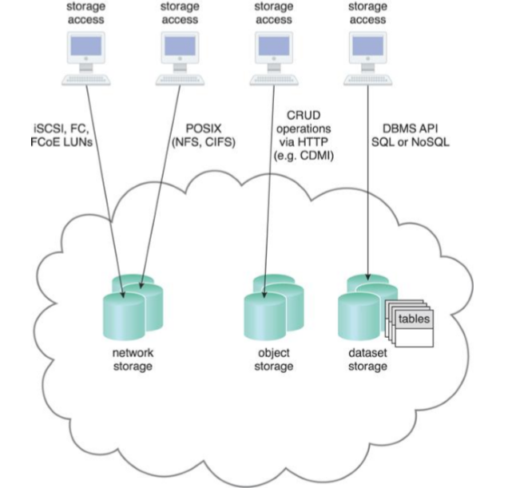
Figure: Different cloud service consumers utilize different technologies to interface with virtualized cloud storage devices.

Slide 20
Network Storage Interfaces
Legacy network storage falls under the category of network storge interface.
It include storage devices with industry standard protocols such as SCSI for storage blocks, server message blocks(SMB), common file system (CIFS), network file system(NFS) for file and network storage.
In file storage system each data stores in a separate file with different file size and formats organized in to folders and subfolders.
When cloud storage device mechanism is based on this type interface its data searching and extraction is suboptimal.
Block storage allows data to be stored in a fixed format(Data Blocks) that can be accessed and the storage format is closest to hardware.
Using logical unit number or virtual volume block-level storage is better than file-level storage.

Slide 21
Object Storage Interfaces
Various types of data can be stored as web resources. This is referred as object storage.
Cloud Storage Device mechanisms that implement this interface can typically be accessed via REST or Web service-based cloud services using HTTP as the prime protocol.
The Storage Networking Industry Association’s Cloud Data Management Interface (SNIA’s CDMI) supports the use of object storage interfaces.

Slide 22
Database Storage Interfaces
Cloud storage device mechanisms based on database storage interfaces typically support a query language in addition to basic storage operations.
There are two types
Relational data storage- A cloud storage device mechanism implemented using relational data storage could be based on any number of commercially available database products, such as IBM DB2, Oracle Database, Microsoft SQL Server, and MySQL.
Challenges with the mechanism is scaling and performance.
Scaling a relational cloud storage device vertically can be more complex and cost-ineffective than horizontal scaling.
Non relational data storage –
Non-relational storage (also commonly referred to as NoSQL storage). NoSQL database doesn't use tables for storing data. NoSQL databases, house data within one data structure, such as JSON document.
Since this non-relational database design does not require a schema, it offers rapid scalability to manage large and typically unstructured data sets.
Non-relational storage can be more horizontally scalable than relational storage.

Slide 23
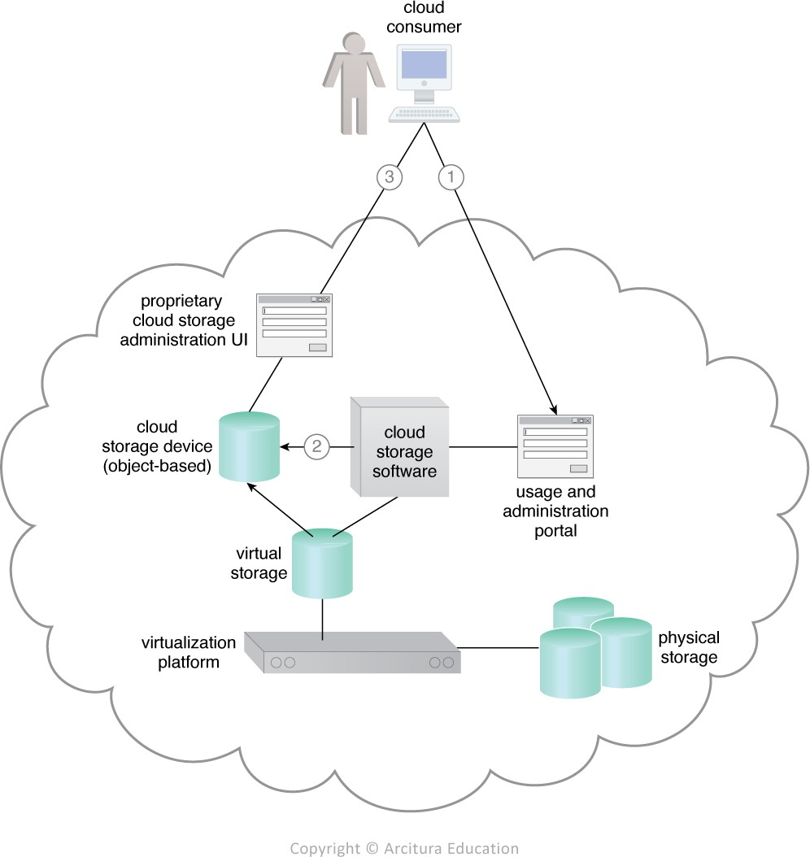
CASE STUDY: DTGOV provides cloud consumers access to a cloud storage device based on an object storage interface.
The object-based cloud storage device has an underlying storage system with variable storage capacity, which is directly controlled by a software component that also exposes the interface. This software enables the creation of isolated cloud storage devices that are allocated to cloud consumers. The storage system uses a security credential management system to administer user-based access control to the device’s data objects .
The cloud consumer interacts with the usage and administration portal to create a cloud storage device and define access control policies (1). The usage and administration portal interact with the cloud storage software to create the cloud storage device instance and apply the required access policy to its data objects (2). Each data object is assigned to a cloud storage device and all of the data objects are stored in the same virtual storage volume. The cloud consumer uses the proprietary cloud storage device UI to interact directly with the data objects (3).

Slide 24
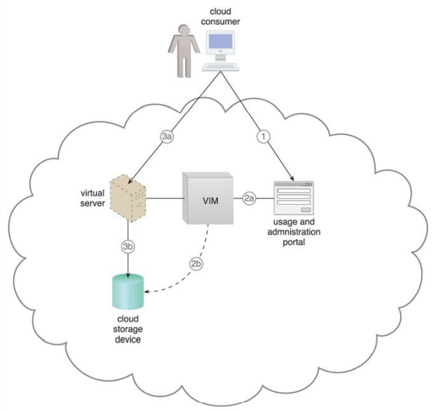
The creation of the cloud consumers’ block-based cloud storage devices is managed by the virtualization platform, which instantiates the LUN’s implementation of the virtual storage.
The cloud consumer uses the usage and administration portal to create and assign a cloud storage device to an existing virtual server (1). The usage and administration portal interacts with the VIM software (2a), which creates and configures the appropriate LUN (2b). Each cloud storage device uses a separate LUN controlled by the virtualization platform. The cloud consumer remotely logs into the virtual server directly (3a) to access the cloud storage device (3b).

Slide 25
3.4 Cloud Usage Monitor
The cloud usage monitor mechanism is a lightweight and autonomous software program responsible for collecting and processing IT resource usage data.
Depending on the type of usage metrics there are 3 agent based implementation formats
Monitoring agent
Resource agent
Polling agent.

Slide 26
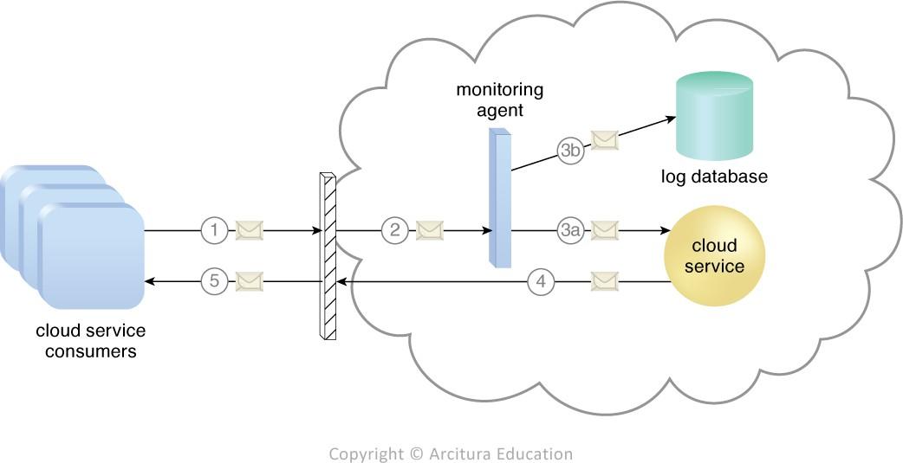
Monitoring agent
A monitoring agent is an intermediary, event driven program that exists as a service agent and reside along existing communication paths to transparently monitor and analyse the dataflows.
This type of cloud usage monitor is used to measure the network traffic and message metrics.
A cloud service consumer sends a request message to a cloud service (1).
The monitoring agent intercepts the message to collect relevant usage data (2)
before allowing it to continue to the cloud service (3a).
The monitoring agent stores the collected usage data in a log database (3b).
The cloud service replies with a response message (4)
that is sent back to the cloud service consumer without being intercepted
by the monitoring agent (5).

Slide 27
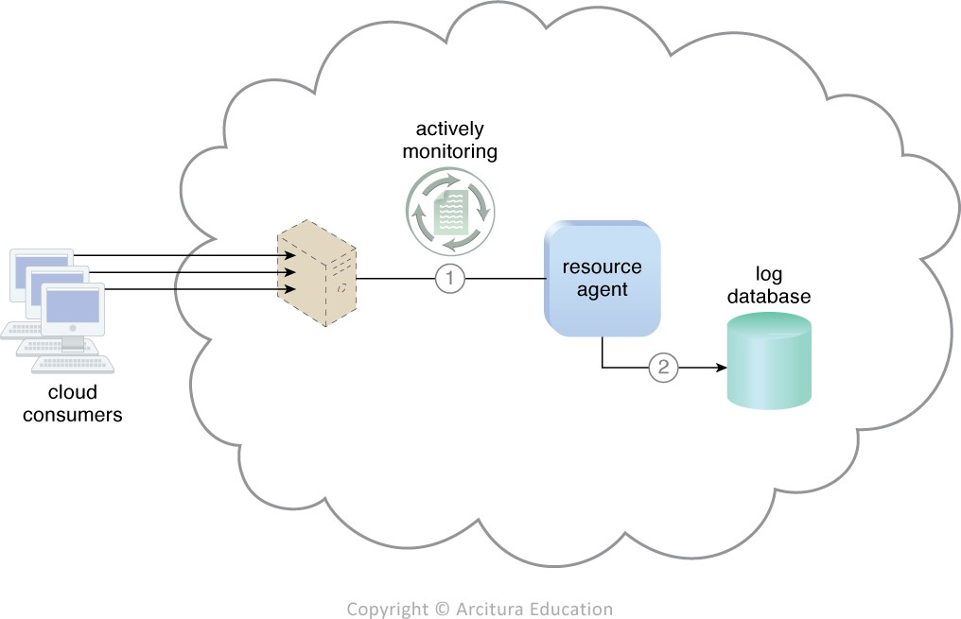
Resource agent
A resource agent is a processing module that collects usage data by having event-driven interactions with specialized resource software.
This module is used to monitor usage metrics based on pre-defined, observable events at the resource software level, such as initiating, suspending, resuming, and vertical scaling.
The resource agent is actively monitoring a virtual server and detects an increase in usage (1). The resource agent receives a notification from the underlying resource management program that the virtual server is being scaled up and stores the collected usage data in a log database, as per its monitoring metrics (2)

Slide 28
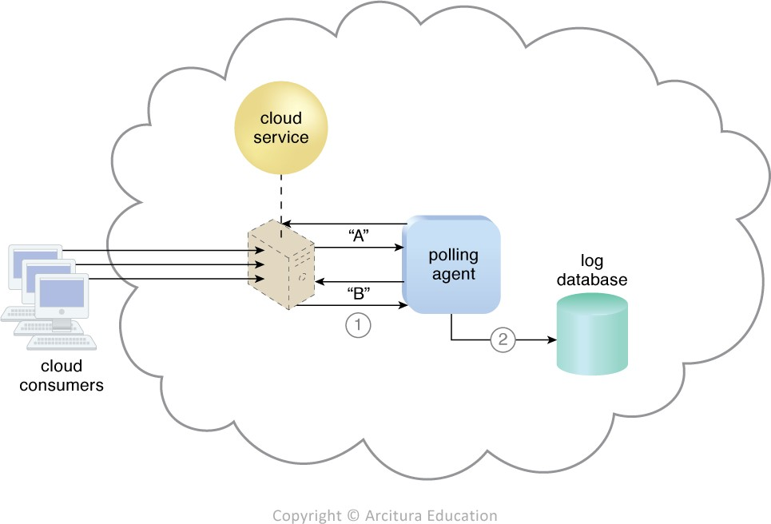
Polling Agent
A polling agent is a processing module that collects cloud service usage data by polling IT resources. This type of cloud service monitor is commonly used to periodically monitor IT resource status, such as uptime and downtime.
A polling agent monitors the status of a cloud service hosted by a virtual server by sending periodic polling request messages and receiving polling response messages that report usage status “A” after a number of polling cycles, until it receives a usage status of “B” (1), upon which the polling agent records the new usage status in the log database (2).

Slide 29
Case study:
DTGOV implements a resource agent that relies on the resource usage events generated by the VIM platform to calculate the virtual server usage data.
The resource agent is designed with logic and metrics that are based on the following rules:
Each resource usage event that is generated by the VIM software can contain the following data:
• Event Type (EV_TYPE) – Generated by the VIM platform, there are five types of events:
VM Starting (creation at the hypervisor)
VM Started (completion of the boot procedure)
VM Stopping (shutting down)
VM Stopped (termination at the hypervisor)
VM Scaled (change of performance parameters)

Slide 30
Contin..
VM Type (VM_TYPE) – This represents a type of virtual server, as dictated by its performance parameters. A predefined list of possible virtual server configurations provides the parameters that are described by the metadata whenever a VM starts or scales.
Unique VM Identifier (VM_ID) – This identifier is provided by the VIM platform.
Unique Cloud Consumer Identifier (CS_ID) – Another identifier provided by the VIM platform to represent the cloud consumer.
Event Timestamp (EV_T) – An identification of an event occurrence that is expressed in date-time format, with the time zone of the data center and referenced to UTC as defined in RFC 3339 (as per the ISO 8601 profile)

Slide 31
Contin..
2. Usage measurements are recorded for every virtual server that a cloud consumer creates.
3. Usage measurements are recorded for a measurement period whose length is defined by two timestamps called tstart and tend. The start of the measurement period defaults to the beginning of the calendar month (tstart = 2012-12-01T00:00:00-08:00) and finishes at the end of the calendar month (tend = 2012-12-31T23:59:59-08:00). Customized measurement periods are also supported.
4. Usage measurements are recorded at each minute of usage. The virtual server usage measurement period starts when the virtual server is created at the hypervisor and stops at its termination

Slide 32
Contin..
5. Virtual servers can be started, scaled, and stopped multiple times during the measurement period. The time interval between each occurrence i (i = 1, 2, 3,...) of these pairs of successive events that are declared for a virtual server is called a usage cycle that is known as Tcycle_i:
• VM_Starting, VM_Stopping – VM size is unchanged at the end of the cycle
• VM_Starting, VM_Scaled – VM size has changed at the end of the cycle
• VM_Scaled, VM_Scaled – VM size has changed while scaling, at the end of the cycle
• VM_Scaled, VM_Stopping – VM size has changed at the end of the cycle

Slide 33

Contin ..
6. The total usage, Utotal, for each virtual server during the measurement period is calculated using the following resource usage event log database equations:
• For each VM_TYPE and VM_ID in the log
• As per the total usage time that is measured for each VM_TYPE, the vector of usage for each VM_ID is Utotal: Utotal = {type 1, Utotal_VM_type_1, type 2, Utotal_VM_type_2, ...}

Slide 34
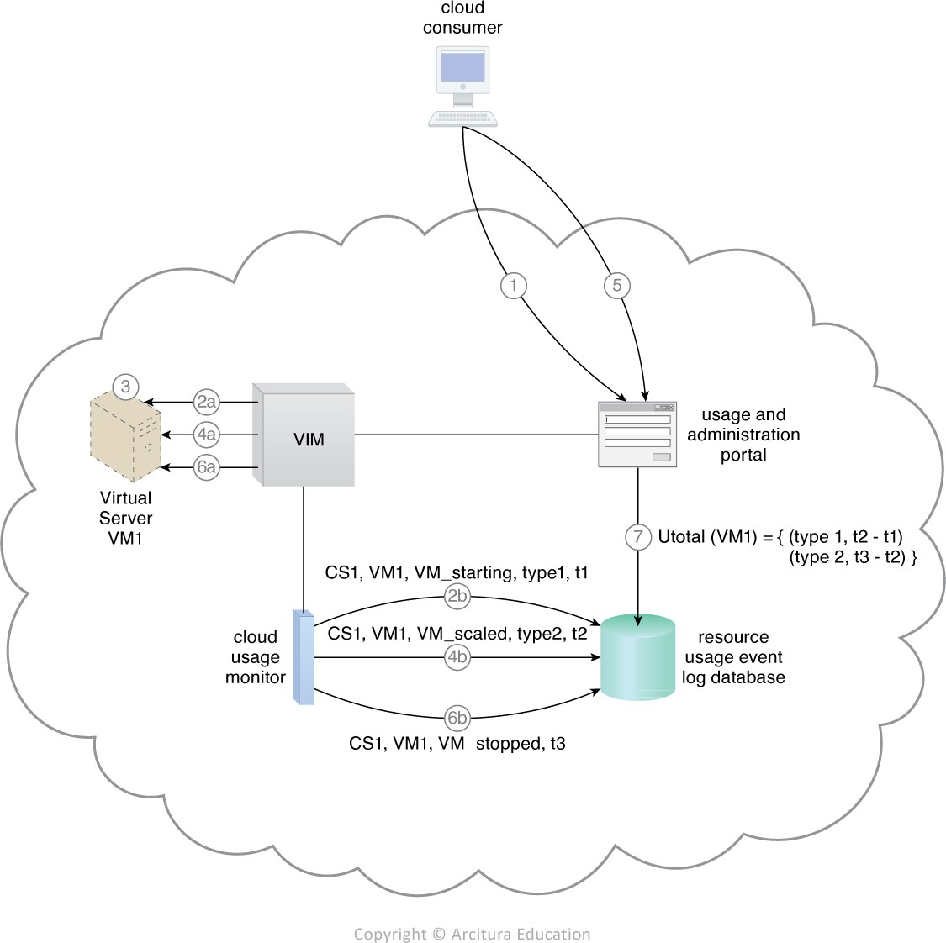
The cloud consumer (CS_ID = CS1) requests the creation of a virtual server (VM_ID = VM1) of configuration size type 1 (VM_TYPE = type1) (1)
The VIM creates the virtual server (2a).
The VIM’s event-driven API generates a resource usage event with timestamp = t1, which the cloud usage monitor software agent captures and records in the resource usage event log database (2b).
Virtual server usage increases and reaches the auto-scaling threshold (3).
The VIM scales up Virtual Server VM1 (4a)
from configuration type 1 to type 2 (VM_TYPE = type2). The VIM’s event-driven API generates a resource usage event with timestamp = t2, which is captured and recorded at the resource usage event log database by the cloud usage monitor software agent (4b).
The cloud consumer shuts down the virtual server (5)
The VIM stops Virtual Server VM1 (6a)
and its event driven API generates a resource usage event with timestamp = t3, which the cloud usage monitor software agent captures and records at the log database (6b).
The usage and administration portal accesses the log database and calculates the total usage (Utotal) for Virtual Server Utotal VM1 (7)

Slide 35
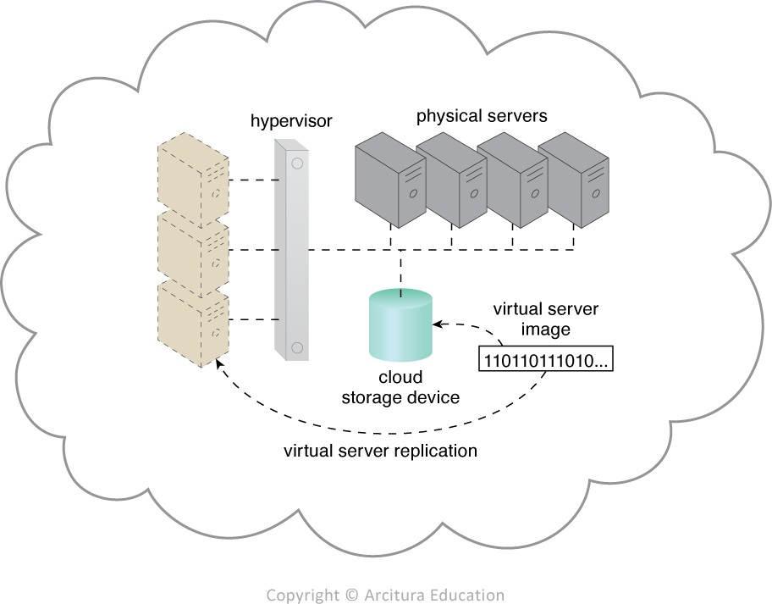
7.5 Resource Replication
Virtualization technology is used to implement the resource replication mechanism to replicate cloud-based IT resources.
The hypervisor replicates several instances of a virtual server, using a stored virtual server image.

Slide 36
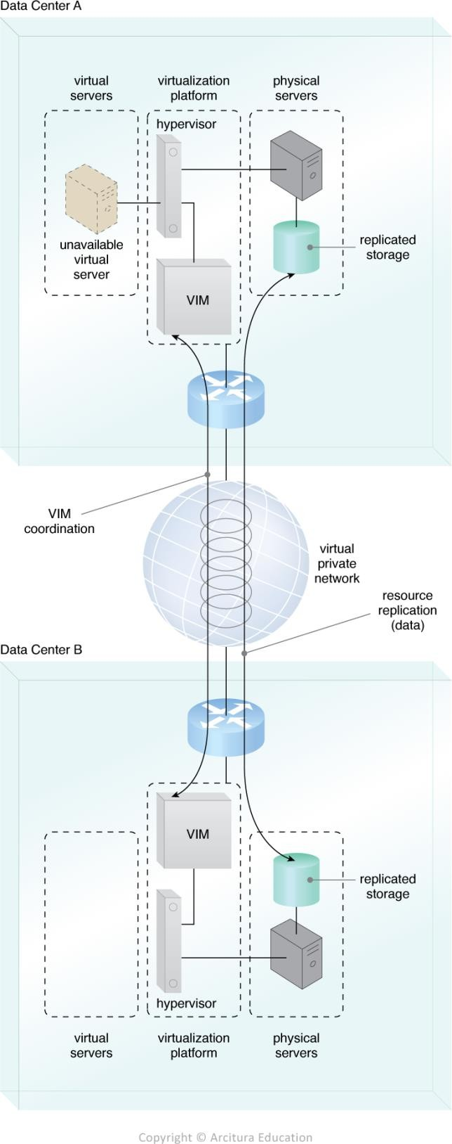
Case study:
DTGOV establishes a set of high-availability virtual servers that can be automatically relocated to physical servers running in different data centers in response to severe failure conditions.
A high availability virtual server is running in Data Center A. VIM instances, in Data Center A and Data Center B, are executing the coordination function that allows detection of failure conditions. Storage of VM images is replicated between data centers, as a consequence of the high availability configuration.

Slide 37

The virtual server becomes unavailable in Data Center A. VIM in Data Center B detects the failure condition and starts to reallocate the high availability server from Data Center A into Data Center B.

Slide 38
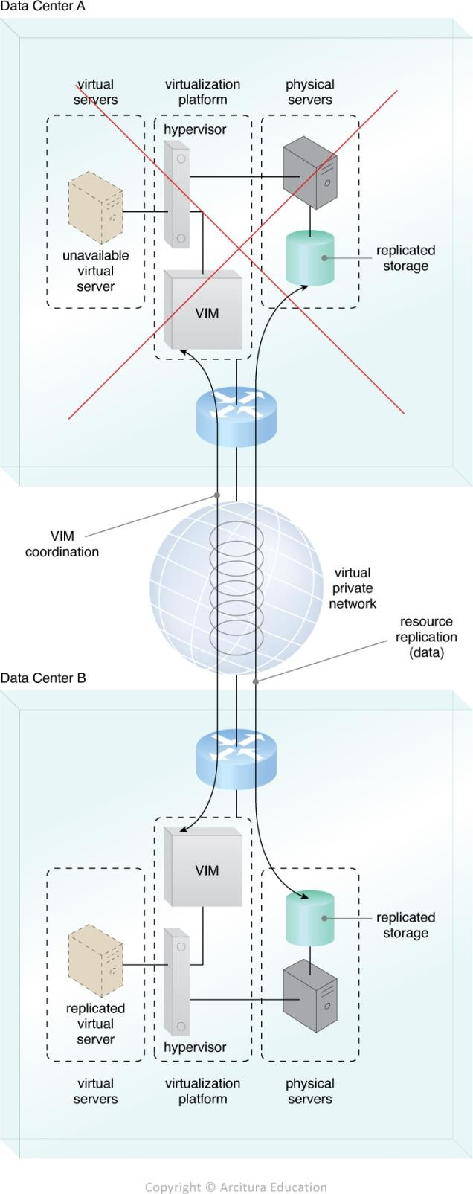
A new instance of the virtual server is created in Data Center B and the service becomes available.

Slide 39
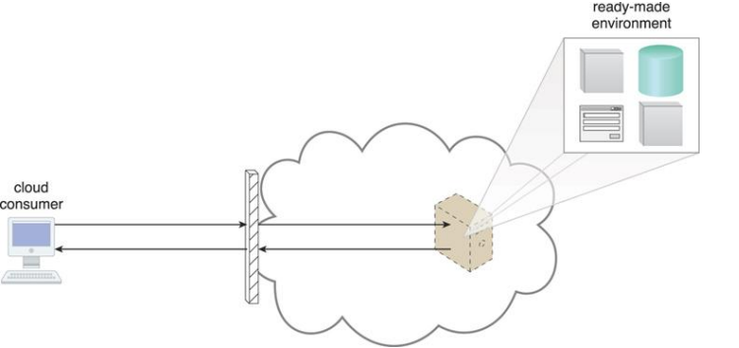
3.6 Ready-Made Environment
The ready-made environment mechanism is a defining component of the PaaS cloud delivery model that represents a predefined, cloud-based platform comprised of a set of already installed IT resources, ready to be used and customized by a cloud consumer.

Slide 40
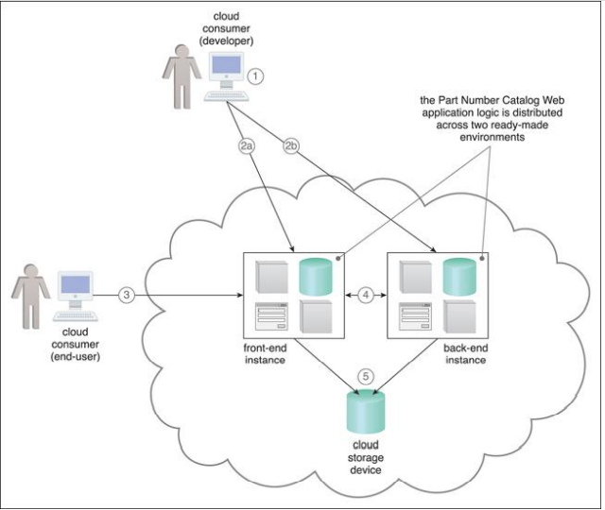
Case study:Development and deployment environment for ATN’s Part Number Catalog application.
The developer uses the provided SDK to develop the Part Number Catalog Web application (1).
The application software is deployed on a Web platform that was established by two ready-made environments called the front-end instance (2a)
and the back-end instance (2b).
The application is made available for usage and one end-user accesses its front-end instance (3).
The software running in the front-end instance invokes a long-running task at the back-end instance that corresponds to the processing required by the end-user (4).
The application software deployed at both the front-end and back-end instances is backed by a cloud storage device that provides persistent storage of the application data (5)

